Slide 1
Information Retrieval
Course Code: BIT 406
Contact Hours: L-3 T-0 P-2
Credits: 4
Semester: 8

Slide 2
Unit 1: Vector Space Model of Retrieval
Word Statistics
Text preprocessing
Term Weighing
Similarity Function
Indexing
Relevance Feedback
Query Expansion(With Local Analysis from External Resources)
The impact of Document Normalization
Multi-Field Retrieval
Evaluation of Retrieval
Applications
Disadvantages
Incentives for Engaging in Electronic Commerce
Forces behind E-commerece

Slide 3
What exactly is Information Retrieval?
Information Retrieval
Information retrieval is defined as the process of accessing and retrieving the most appropriate information from text based on a particular query given by the user, with the help of context-based indexing or metadata.
Google Search is the most famous example of information retrieval.
Information Retrieval Systems
An information retrieval system searches a collection of natural language documents with the goal of retrieving exactly the set of documents that matches a user’s question. They have their origin in library systems.
These systems assist users in finding the information they require but it does not attempt to deduce or generate answers. It tells about the existence and location of documents that might consist of the required information that is given to the user. The documents that satisfy the user’s requirement are called relevant documents. If we have a perfect IR system, then it will retrieve only relevant documents.

Slide 4
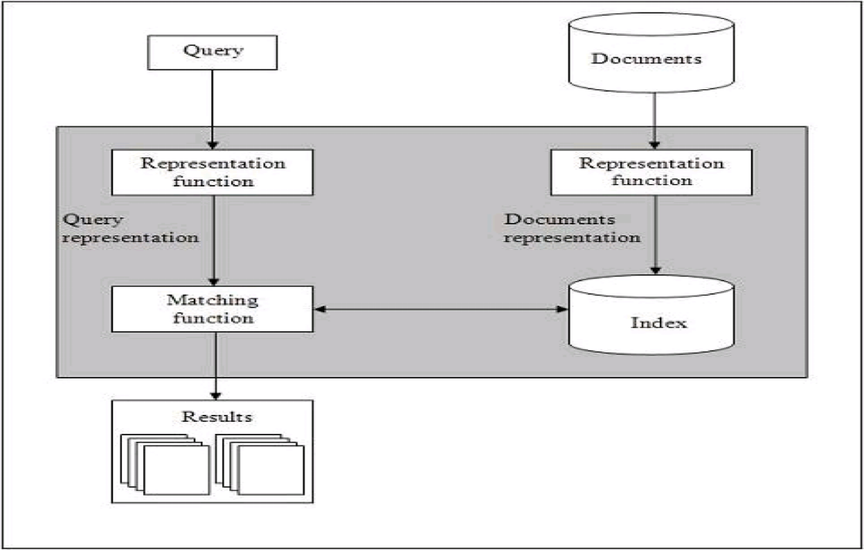
Basics of IR System
The step by step procedure of these systems are as follows:
Indexing the collection of documents.
Transforming the query in the same way as the document content is represented.
Comparing the description of each document with that of the query.
Listing the results in order of relevancy.
Retrieval Systems consist of mainly two processes:
Indexing
Matching

Slide 5
Indexing
It is the process of selecting terms to represent a text. Indexing involves:
Tokenization of string
Removing frequent words
Stemming
Two common Indexing Techniques:
Boolean Model
Vector space model

Slide 6
Matching
It is the process of finding a measure of similarity between two text representations. The relevance of a document is computed based on the following parameters:
1. TF: It stands for Term Frequency which is simply the number of times a given term appears in that document.
TF (i, j) = (count of ith term in jth document)/(total terms in jth document)
2. IDF: It stands for Inverse Document Frequency which is a measure of the general importance of the term.
IDF (i) = (total no. of documents)/(no. of documents containing ith term)
3. TF-IDF Score (i, j) = TF * IDF

Slide 7
Information Retrieval Models
Information retrieval models predict and explain what a user will find in relevance to the given query and consists of the following:
A model for documents.
A model for queries.
A matching function that compares queries to documents.
Mathematically, a retrieval model consists of the following components:
D: Representation for documents.
R: Representation for queries.
F: The modeling framework for D, Q along with the relationship between them.
R (q, di): A ranking or similarity function that orders the documents with respect to the query.

Slide 8
Types of IR Model
Classical IR Models: These are the simplest and easy-to-implement IR models. These are based on mathematical knowledge that was easily recognized and understood as well. Following are the examples of classical IR models:
Boolean models,
Vector models,
Probabilistic models.
Non-Classical IR Models: These are completely opposite to the classical IR models. These are based on principles other than similarity, probability, Boolean operations. Following are the examples of Non-classical IR models:
Information logic models,
Situation theory models,
Interaction models.
Alternative IR Models: It is the enhancement of the classical IR model that makes use of some specific techniques from some other fields. Following are the examples of Alternative IR models:
Cluster models,
Fuzzy models,
Latent Semantic Indexing (LSI) models.

Slide 9
Vector Space Model
This is based on Luhn’s similarity criterion, which states that “the more two representations agreed in given elements and their distribution, the higher would be the probability of their representing similar information”.
1. In this model, the index representations (documents) and the queries are represented by vectors in a T dimensional Euclidean space.
2. T represents the number of distinct terms used in the documents.
3. Each axis corresponds to one term.
4. Ranked list of documents ordered by similarity to the query where the similarity between a query and a document is computed using a metric on the respective vectors.
5. The similarity measure of a document vector to a query vector is usually the cosine of the angle between them.

Slide 10
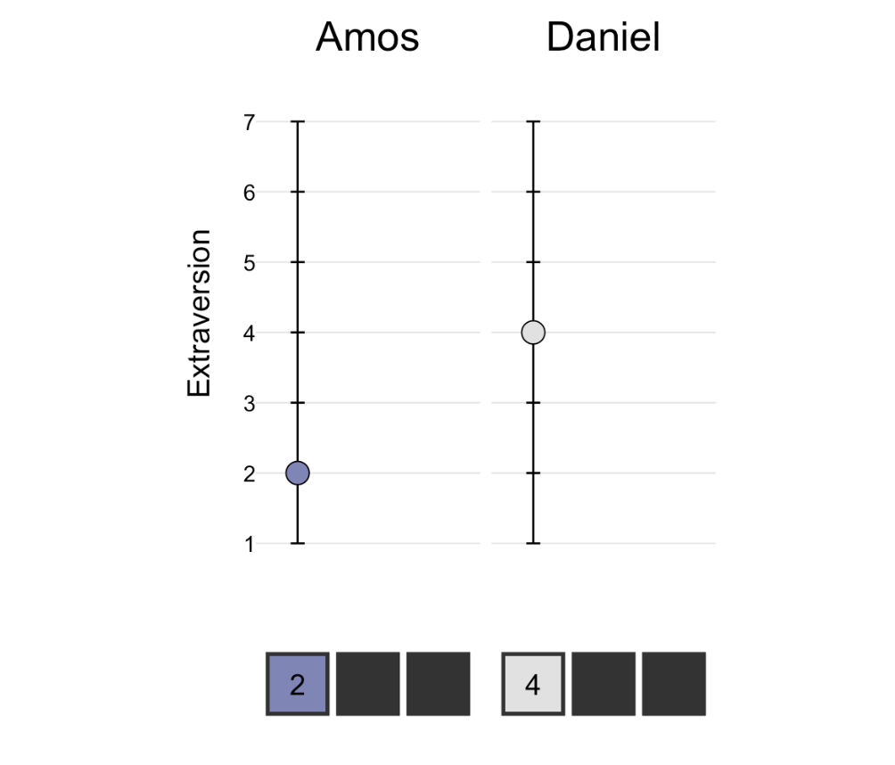
Fictional Example to understand vector Space Model
A fictional example¹: Daniel and Amos filled out a psychology questionnaire. The questionnaire measured three aspects of their personalities: extraversion, openness to experience, and neuroticism.
On the extraversion scale, Amos scored a 2 and Daniel scored a 4

Slide 11
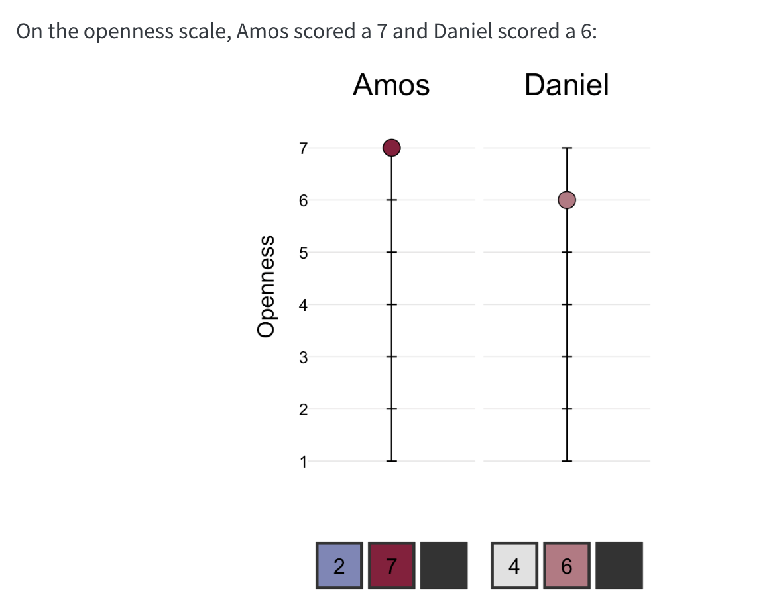
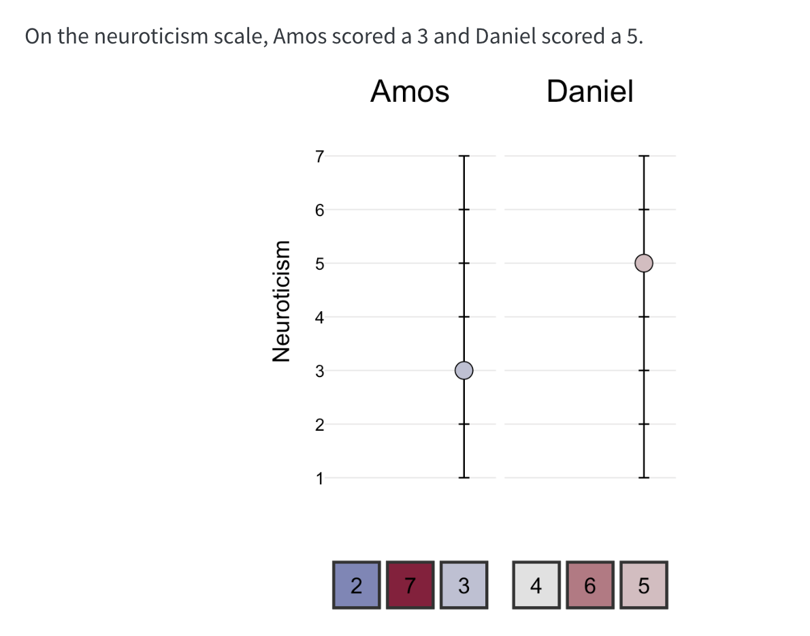
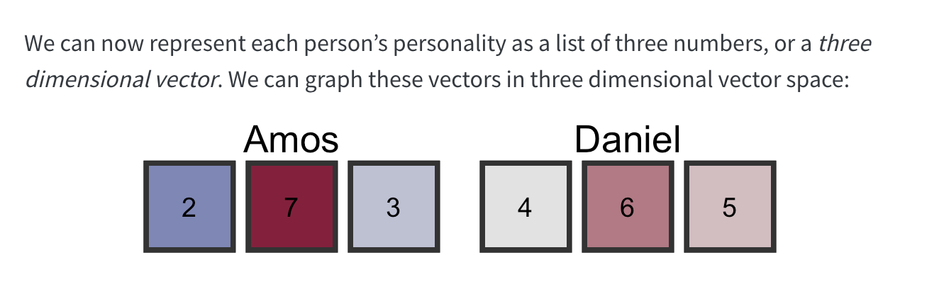

Slide 12
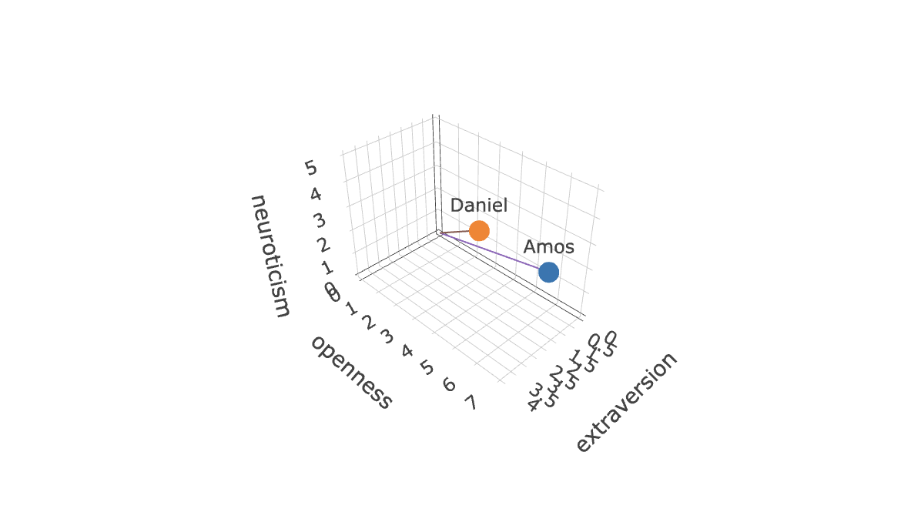
https://ds4psych.com/vectorspace-intro

Slide 13
Unit 1: Vector Space Model of Retrieval
Word Statistics
Text preprocessing
Term Weighing
Similarity Function
Indexing
Relevance Feedback
Query Expansion(With Local Analysis from External Resources)
The impact of Document Normalization
Multi-Field Retrieval
Evaluation of Retrieval
Applications
Disadvantages
Incentives for Engaging in Electronic Commerce
Forces behind E-commerece

Slide 14
Word Statistics
In the Vector Space Model (VSM), "word statistics" refer to how word occurrences (like Term Frequency - TF) and their overall importance (Inverse Document Frequency - IDF) are quantified and used to create numerical vector representations (embeddings) for words and documents, enabling similarity comparisons and semantic analysis.
Key statistics include:
raw counts (Bag-of-Words)
weighted frequencies (TF-IDF)
learned contextual patterns (Word Embeddings like Word2Vec), capturing meaning through co-occurrence in high-dimensional spaces.

Slide 15
Key Word Statistics & Concepts in VSM:
Term Frequency (TF): How often a word appears in a specific document, indicating its local importance.
Inverse Document Frequency (IDF): Measures a word's global rarity; common words get lower scores, rare words get higher scores, highlighting their significance across the entire collection (corpus).
TF-IDF: Combines TF and IDF to weight words, giving higher scores to terms that are frequent in a document but rare overall, creating a sparse vector.
Bag-of-Words (BoW): A simple model where each unique word in the corpus becomes a dimension, and document vectors are built from raw word counts, ignoring word order.
Word Embeddings (Word2Vec, GloVe): Modern VSMs that learn dense, low-dimensional vectors for words, capturing semantic relationships (e.g., "king" - "man" + "woman" ≈ "queen") through neural networks and context.

Slide 16
Python Lab 1
https://colab.research.google.com/drive/1BGZPZe91EBJJbM9u65vFet4ti996xIRD?usp=sharing
Calculate TF,DF, TF-IDF, Bag of words from several documents(at least 3 different docs). Also note that this must be done without using Python Libraries.

Slide 17
Unit 1: Vector Space Model of Retrieval
Word Statistics
Text preprocessing
Term Weighing
Similarity Function
Indexing
Relevance Feedback
Query Expansion(With Local Analysis from External Resources)
The impact of Document Normalization
Multi-Field Retrieval
Evaluation of Retrieval
Applications
Disadvantages
Incentives for Engaging in Electronic Commerce
Forces behind E-commerece

Slide 18
Text Preprocessing
Preprocessing Task | Reasons
Noise Reduction | Text data often contains noise such as punctuation, special characters, and irrelevant symbols. Preprocessing helps remove these elements, making the text cleaner and easier to analyze.
Normalization | Different forms of words (e.g., “run,” “running,” “ran”) can convey the same meaning but appear in different forms. Preprocessing techniques like stemming and lemmatization help standardize these variations.
Tokenization | Text data needs to be broken down into smaller units, such as words or phrases, for analysis. Tokenization divides text into meaningful units, facilitating subsequent processing steps like feature extraction.
Stopword Removal | Stopwords are common words like “the,” “is,” and “and” that often occur frequently but convey little semantic meaning. Removing stopwords can improve the efficiency of text analysis by reducing noise.
Feature Extraction | Preprocessing can involve extracting features from text, such as word frequencies, n-grams, or word embeddings, which are essential for building machine learning models.
Dimensionality Reduction | Text data often has a high dimensionality due to the presence of a large vocabulary. Preprocessing techniques like term frequency-inverse document frequency (TF-IDF) or dimensionality reduction methods can help.

Slide 19
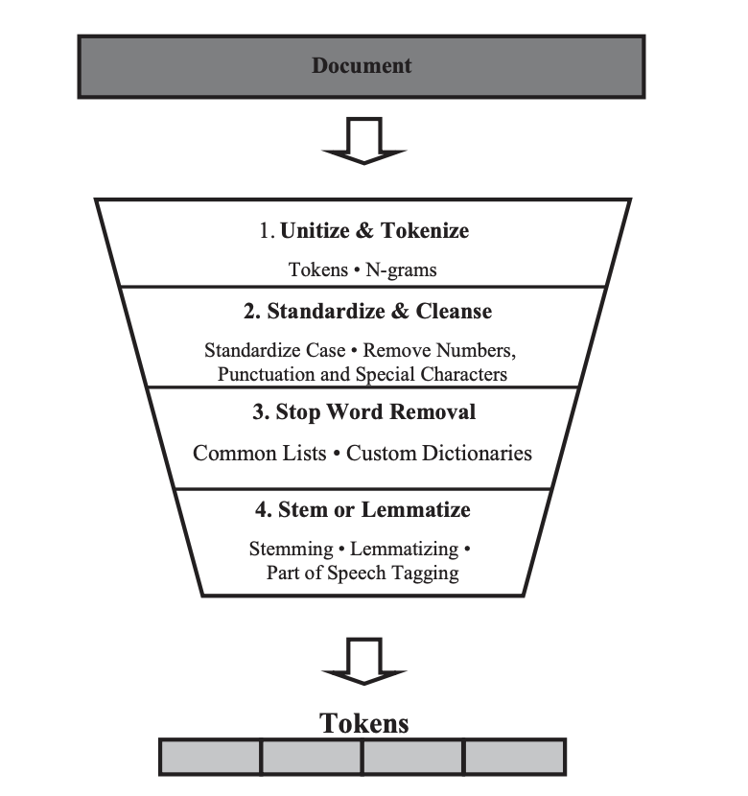
Text Preprocessing
Much of the text preparation and preprocessing methods have their roots in natural language processing.
Text preprocessing takes an input of raw text and returns cleansed tokens.
Tokens are single words or groups of words that are tallied by their frequency and serve as the features of the analysis.
The preprocessing process includes
(1) unitization and tokenization,
(2) standardization and cleansing or text data cleansing,
(3) stop word removal, and
(4) stemming or lemmatization.
This process is depicted in Figure.
Each step removes unnecessary information from the original text.
NEED of PREPROCESSING
Proper preprocessing of text data sets up the analysis for success. In text analysis, far more time is spent in preparing and preprocessing the text data than in the analysis itself (Dumais et al. 1998).
Diligent and detailed work in cleansing and preprocessing makes the analysis process smoother.
The stages along the pipeline standardize the data, thereby reducing the number of dimensions in the text dataset. There is a balance between retained information and reduced complexity in the choices made during the process.

Slide 20
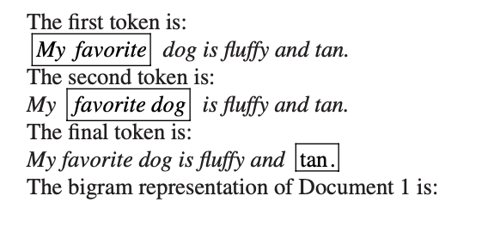
N-grams
N-grams are an alternative to single words in the tokenization process.
N-grams are tokens; they are consecutive word sequences with length n.
For instance, bigrams are tokens composed of two side-by-side words; a single word is known as a unigram.
N-grams retain information about the co-occurrence of words, because they group adjacent words into the same token.
Visualize the process as a picture frame that contains n words. Initially, the frame rests over the first n words. This counts as a token. The frame then moves over one word resulting in the exclusion of the first word. This is the second token. This process repeats for the length of the text (Struhl 2015).

Slide 21
Standardization and Cleaning
First, we want to standardize and clean the tokens. These transformations level the playing field by making the terms in each of the documents comparable. For instance, we do not want character, character, and Character to be considered separate items just because one has a comma, and another has an upper case C. This standardization and cleaning prevents this possibility from occurring.
Our first step is to convert the terms in the text to lower case. In this step, any capital letters are converted to lower case.
Following this conversion, we want to remove numbers, punctuation, and special characters. In real-world text data, there may be additional characters and tokens to clean. For instance, in some text documents, there may be extra spaces, such as white space. These are also eliminated at this stage.

Slide 22
Stop Word Removal
Next, we want to drop frequently used filler words, or stop words, which add no value to the analysis. According to the Oxford English Dictionary, and, the, be, to, and of are the most common words in the English language.
In the case of text analysis, we remove common terms because, although common terms such as these serve a grammatical purpose, they provide little information in terms of content (Salton 1989; Wilbur and Sirotkin 1992).
A collection of stop words is known as a stop list. Alternatively, this collection of words can be known as a dictionary. These lists include many different languages and methods.2 The SMART information retrieval system, introduced by Salton (1971), has a popular stop word list containing 571 words.

Slide 23
Custom Stop Word Dictionaries
Standard stop word dictionaries eliminate many of the most common words in a given language, but sometimes we also want to drop domain- or project-specific words or tokens.
In this case we can build a custom dictionary to complete this task. Often, projects will have topic-specific words that occur frequently but add little value.
To identify these words, we can also look at term frequencies. Words that have high frequencies across all documents in our collection but do not provide informational content are good candidates for removal. After making these choices, we can select a subset of the data with the term in it and read it.
While reading, we want to ensure that the term does not provide information that is relevant to the analysis question. In the creation of a custom stop word dictionary, the process should be repeated, creating subsets for reading several times to check for multiple uses of the term (Inmon 2017).
Custom dictionaries can be used in many text analysis projects and not exclusively to filter stop words. Custom dictionaries are created in information retrieval to find keywords in context (KWIC). Instead of finding tokens for removal, these keywords are used as search terms.

Slide 24
Stemming and Lemmatization
The final stage is to perform either stemming or lemmatization on the documents.
Stemming and lemmatization involve breaking words down to their root word.
Stemming involves the removal of a word’s suffix to reduce the size of the vocabulary (Porter 1980).
Lemmatization is similar to stemming, except it incorporates information about the term’s part of speech (Yatsko 2011).
Both methods combine words that contain the same root into a single token to reduce the number of unique tokens within the analysis set.
Words with a common root often share a similar meaning.
These words are then grouped into one token (Manning et al. 2008). There are exceptions to the roots of words sharing the same meaning, but the added reduction in complexity is often worth the price of incorrectly categorizing a few words.
As an example, let’s use the root train. Train has several forms, including:
– Train
– Trains
– Trained
– Training
– Trainer

Slide 25
Lemmatization
One difficulty encountered with stemming (and text analytics in general) is that a single word could have multiple meanings depending on the word’s context or part of speech.
Lemmatization deals with this problem by including the part of speech in the rules grouping word roots. This inclusion allows for separate rules for words with multiple meanings depending on the part of speech (Manning et al. 2008).
This method helps improve the algorithm by correctly grouping tokens at the cost of added complexity.

Slide 26
Python Lab 2
https://colab.research.google.com/drive/1lrSkIRz-2cpsUftgc5Ma7iLxOWx2Cdm3?usp=sharing
https://www.kaggle.com/datasets/uciml/sms-spam-collection-dataset?resource=download
Perform all the Data Preprocessing Steps on any Textual Dataset

Slide 27
Unit 1: Vector Space Model of Retrieval
Word Statistics
Text preprocessing
Term Weighting
Similarity Function
Indexing
Relevance Feedback
Query Expansion(With Local Analysis from External Resources)
The impact of Document Normalization
Multi-Field Retrieval
Evaluation of Retrieval
Applications
Disadvantages
Incentives for Engaging in Electronic Commerce
Forces behind E-commerece

Slide 28
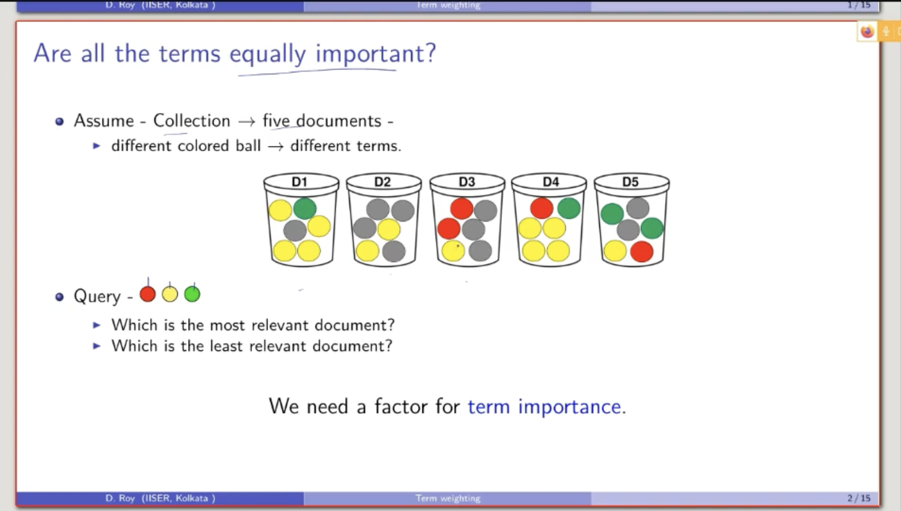
Term Weighting
Query 1: No of times a term is appearing in the document
d1:5
d2:2
d3:3
d4:6
d5:4
Query 2: Whether the query term is appearing or not
d1:2
d2:1
d3:2
d4:3
d5:3

Slide 29
Introduction to Term Weighting (Ranked Retrieval)
Information Retrieval → finding relevant documents for a user’s query
Earlier: Boolean model → document is relevant or not, no ranking
Now: Ranked retrieval → some documents are more relevant than others
Goal: assign a score to each document for a query, and rank by score
Term weighting = deciding how important each word (term) is in scoring

Slide 30
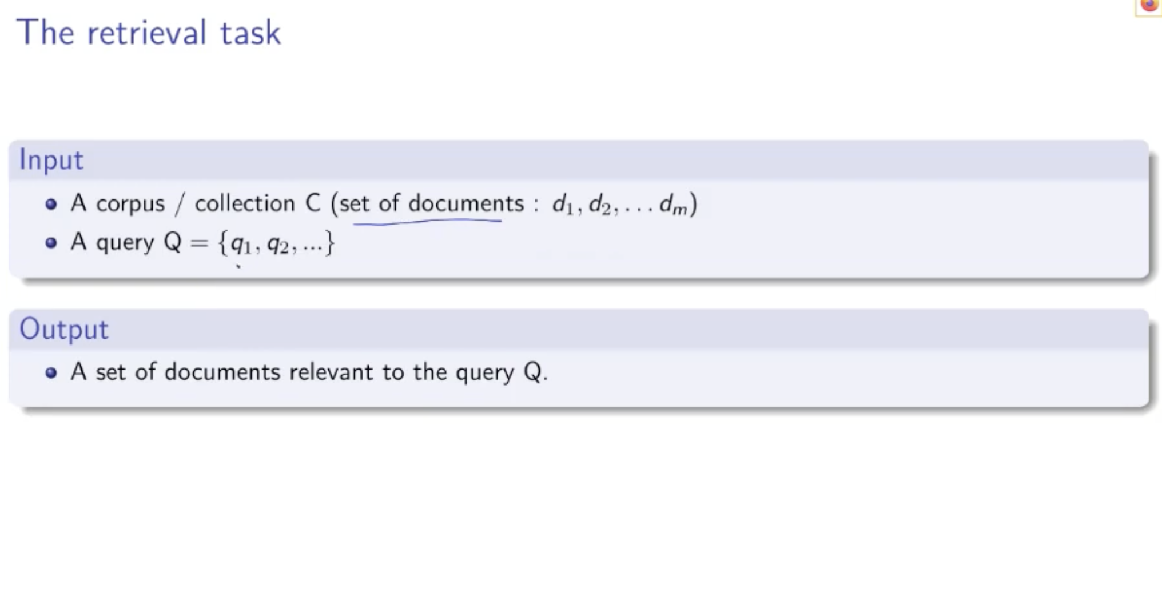
Retrieval Task and Topical Relevance
Input to retrieval model:
A collection / corpus of documents
A query (few terms: free-text / keyword query)
Output:
Documents that are topically relevant to the query
Topical relevance:
Query and document talk about the same topic
Example: query = “atom bomb” → relevant docs discuss atom bombs
In Boolean retrieval:
Exact match only → relevant / not relevant
No concept of “more relevant” vs “less relevant”
In Ranked retrieval:
Use a best-match model
Approximate relevance by similarity(query, document)

Slide 31
Bag-of-Words & Scoring Documents
A document is viewed as a bag of terms (order ignored)
“John is quicker than Mary”
“Mary is quicker than John” → Treated as the same bag of words
To score a document for a query:
Combine scores of individual terms in the document
Document score = sum or product of term scores
Important simplification:
Only query terms contribute to the score
If a query term does not appear in a document → its contribution = 0
Non-query terms in the document are ignored for scoring
So, for query Q = {q₁, q₂, q₃} and document D:
Score(D, Q) = combine weights of q₁ in D, q₂ in D, q₃ in D
These individual term weights reflect term importance

Slide 32
Term Frequency as Term Weight
Term Frequency (TF):
TF(t, d) = number of times term t occurs in document d
Used as first measure of term importance in a document
But raw TF has problems:
If TF(q, d₁) = 10 and TF(q, d₂) = 100 → d₂ is not really 10× more relevant
Could just be repetition of the same content
Relevance does not grow linearly with TF
Solution: log-frequency weighting (damping TF)
If TF(t, d) > 0:
weight(t, d) = 1 + log₁₀(TF(t, d))
If TF(t, d) = 0:
weight(t, d) = 0
Effect:
TF = 1 → weight ≈ 1
TF = 2 → ≈ 1.3
TF = 10 → 2
TF = 1000 → 4 → Big TF values no longer explode the score

Slide 33
Rare Terms, Document Frequency & IDF (Preview)
Not all terms are equally useful for retrieval:
Common words (e.g., “the”, “is”, “person”) appear in many documents
Rare words (e.g., “capricious”) are more discriminative
Document Frequency (DF):
DF(t) = number of documents in which term t appears at least once
High DF → very common term
Low DF → rare term
We want rare terms to get higher weight
Idea: Inverse Document Frequency (IDF)
IDF(t) ≈ log(N / DF(t)), where N = total number of documents
Common terms (high DF) → low IDF
Rare terms (low DF) → high IDF
Together with TF (and log TF), IDF leads to TF–IDF weighting, which is the foundation of many ranked retrieval models

Slide 34
Recap: Why Term Weighting?
Retrieval ranks documents based on relevance to a query
Early idea: Binary model
1 → term present
0 → term absent
Improved idea: Use term frequency (TF) instead of binary match
Term weights act as a signal for relevance
Goal: Assign appropriate weight so rarer & meaningful terms influence ranking more

Slide 35
From Binary Presence → Term Incidence Vector
For each term (e.g., “india”) build a vector over all documents
Document index i contains:
1 → term appears in doc i
0 → term absent in doc i
Vector length = number of documents (M)
Forms basis for Boolean Retrieval Model
But Boolean retrieval doesn’t differentiate more relevant vs less relevant

Slide 36
Term Frequency (TF) + Log Damping
Store counts instead of just presence = TF(t,d)
Problem: raw TF increases linearly, but relevance does not
Solution: Sublinear scaling using log
If TF > 0: → weight(t,d) = 1 + log₁₀(TF(t,d)) Else: → 0
Effect Example:
TF=1 → weight=1
TF=2 → 1.3
TF=10 → 2
TF=1000 → 4 → Big TF doesn’t explode score

Slide 37
Why Rare Terms Matter (Intuition)
Rare terms are more informative than common terms
Example query: “diseases caused by smoking”
Relevant info mostly in “diseases” + “smoking”
Term “cause/caused” is too generic → less useful for retrieval
Rarity depends on collection, not dictionary
Stop words removed, but many non-stopwords are still frequent

Slide 38
Unit 1: Vector Space Model of Retrieval
Word Statistics
Text preprocessing
Term Weighing
Similarity Function
Indexing
Relevance Feedback
Query Expansion(With Local Analysis from External Resources)
The impact of Document Normalization
Multi-Field Retrieval
Evaluation of Retrieval
Applications
Disadvantages
Incentives for Engaging in Electronic Commerce
Forces behind E-commerece

Slide 39
Similarity Function
A similarity function in information retrieval is a mathematical formula that calculates a numerical score indicating how closely a document matches a user query.
These functions rank documents by measuring the proximity of vector representations (like term frequency) in a vector space model, with higher scores indicating higher relevance.
Common examples include cosine, Jaccard, and Euclidean distance, typically resulting in scores between 0 and 1.
Key Aspects of Similarity Functions
Purpose: To rank documents by relevance, allowing retrieval systems to return the most relevant items first, rather than just exact matches.

Slide 40
Types of Measures:
Cosine Similarity: Measures the cosine of the angle between two vectors, focusing on the orientation rather than magnitude, which is effective for varying document lengths.
Jaccard Similarity: Calculates the ratio of shared terms (intersection) to the total unique terms (union) between two documents, ranging from 0 to 1.
Euclidean Distance: Measures the straight-line distance between two points in vector space; smaller distances indicate higher similarity.

Slide 41
Cosine Similarity
Cosine similarity is a widely used similarity measure that calculates the cosine of the angle between two vectors in a multi-dimensional space. In the context of text documents represented as term frequency vectors, cosine similarity computes the cosine of the angle between the vectors representing the documents.
Cosine similarity ranges from -1 to 1, with 1 indicating perfect similarity, 0 indicating no similarity, and -1 indicating perfect dissimilarity.

Slide 42
cosine similarity becomes wrong if the two document vectors don’t use the same word order (same feature alignment).
Vocabulary (correct shared order)
Let the vocabulary be:
["cat", "dog"]
Documents
Doc1: "cat"
Doc2: "dog"
✅ Correct vectors (same order for both)
Using order ["cat","dog"]:
Doc1 → [1, 0]
Doc2 → [0, 1]
Cosine similarity:
dot = 1·0 + 0·1 = 0
magnitudes = 1 and 1
similarity = 0 / (1·1) = 0 ✅ (they share no words)
❌ Wrong case (different order used for Doc2)
Suppose by mistake you build Doc2’s vector using reversed order:
["dog", "cat"]
Then:
Doc1 (still using ["cat","dog"]) → [1, 0]
Doc2 (using ["dog","cat"]) → [1, 0] ← because “dog” count comes first
Now cosine similarity:
dot = 1·1 + 0·0 = 1
magnitudes = 1 and 1
similarity = 1 / (1·1) = 1 ❌
It falsely says Doc1 and Doc2 are identical, even though they share zero common words.
Key takeaway
Cosine similarity assumes:
Index 0 in both vectors represents the same word, index 1 represents the same word, etc.
If the order differs, you’re multiplying counts of different terms together → wrong result.

Slide 43
Jaccard Similarity
In information retrieval, Jaccard similarity (or Jaccard index) is a metric used to measure the overlap between a user's query and a document. It treats both the query and the document as sets of unique terms and is calculated as the size of their intersection divided by the size of their union.
Jaccard similarity is a measure of similarity between two sets defined as the size of the intersection divided by the size of the union of the sets. In the context of text documents, Jaccard similarity is often used to compare the overlap of terms between two documents.
Jaccard similarity ranges from 0 to 1, with 1 indicating perfect similarity and 0 indicating no similarity.

Slide 44
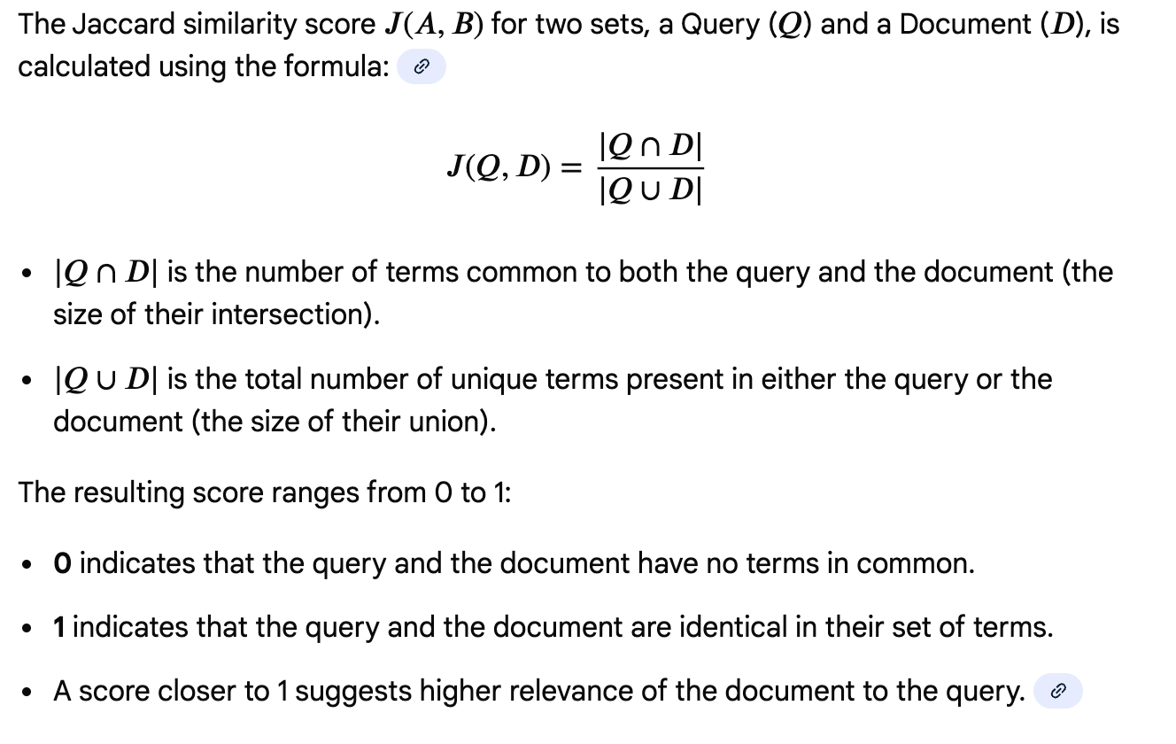
Jaccard Similarity

Slide 45
Consider a query and two documents after basic text processing (tokenization and removal of stop words like "the", "in", "of"):
Query (Q): {ides, march}; Document 1 (D1): {caesar, died, march}; Document 2 (D2): {long, march}
Calculation for Document 1:
𝑄∩𝐷1 : {march} (1 common term)
𝑄∪𝐷1 : {ides, march, caesar, died} (4 unique terms)
J(Q,D1)=1/4=0.25
Calculation for Document 2:
𝑄∩𝐷2 : {march} (1 common term)
𝑄∪𝐷2 : {ides, march, long} (3 unique terms)
J(Q,D2)=1/3≈0.33
Based on Jaccard similarity, Document 2 is considered slightly more relevant to the query than Document 1, as it has a higher Jaccard score.

Slide 46
Advantages and Limitations
Simple and intuitive: It is easy to understand and implement.
Effective for set-based similarity: Works well when only the presence or absence of terms matters.
Handles different sizes: The query and document do not need to be the same size for the calculation.
Limitations:
Ignores term frequency: It does not consider how many times a term appears, only whether it is present.
Ignores term importance/weighting: Rare, more informative terms are treated the same as common, less informative terms.
Sensitive to document length: It can yield low scores for very long documents that have a small overlap with a short query, even if the overlap is highly relevant.

Slide 47
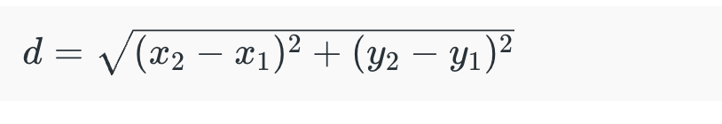
Euclidean Distance
Euclidean distance measures the straight-line distance between two points in a multi-dimensional space. In the context of text documents represented as vectors, Euclidean distance calculates the length of the straight line connecting the two vectors.
Lower values of Euclidean distance indicate higher similarity between documents.

Slide 48
Manhattan Distance
Manhattan distance, also known as city block distance or taxicab distance, measures the distance between two points by summing the absolute differences of their coordinates.
In the context of text documents, Manhattan distance calculates the sum of the absolute differences between the corresponding elements of the vectors representing the documents.
Like Euclidean distance, lower values of Manhattan distance indicate higher similarity between documents

Slide 49
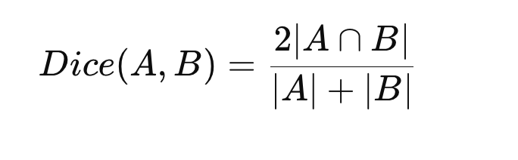
Dice Coefficient
The Dice coefficient is another similarity measure commonly used for comparing the similarity between two sets. In the context of text documents, it calculates the ratio of the size of the intersection of terms to the total number of terms in both documents.
The Dice coefficient ranges from 0 to 1, with 1 indicating perfect similarity and 0 indicating no similarity.

Slide 50
Levenshtein Distance
Levenshtein distance, also known as edit distance, measures the minimum number of single character edits (insertions, deletions, or substitutions) required to change one string into another.
In the context of text documents, Levenshtein distance can be used to compare the similarity between two text strings.
Lower values of Levenshtein distance indicate higher similarity between text strings.

Slide 51
Levenshtein Distance measures how many edits are needed to change one word into another.
Allowed Operations
Only 3 operations are allowed:
1️⃣ Insertion → Add a character 2️⃣ Deletion → Remove a character 3️⃣ Substitution → Replace a character
Simple Example
Convert: cat → cut
Operation:
a → u (substitution)
Distance = 1
Another Example
kitten → sitting
Operations:
kitten → sitten (substitute k → s)
sitten → sittin (substitute e → i)
sittin → sitting (insert g)
Distance = 3
Why It Is Useful?
✔ Spell checking ✔ Autocomplete ✔ DNA sequence matching ✔ Search engines ✔ Plagiarism detection

Slide 52
Pearson Correlation Coefficient
Pearson correlation coefficient measures the linear correlation between two variables.
In the context of text documents represented as vectors, Pearson correlation coefficient calculates the correlation between the elements of the vectors.
Pearson correlation coefficient ranges from -1 to 1, with 1 indicating perfect positive correlation, -1 indicating perfect negative correlation, and 0 indicating no correlation.
Pearson coefficient measures how strongly two document word-frequency patterns are related.

Slide 53
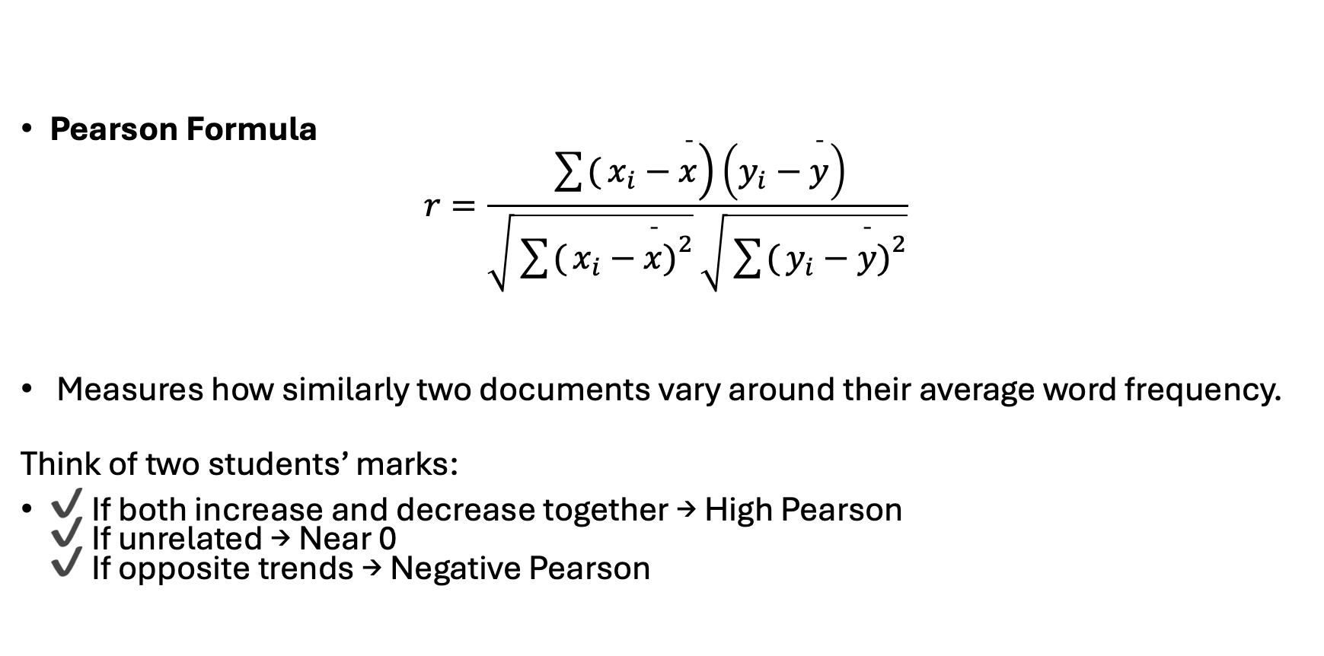
Pearson Correlation Coefficient
Pearson Formula
$$r=\frac{\sum{(}\left.x_{i}−\overset{ˉ}{x}\right)\left(y_{i}−\overset{ˉ}{y}\right)}{\sqrt{\sum{(}\left.x_{i}−\overset{ˉ}{x}{\left.)\right.}^{2}\right.}\sqrt{\sum{(}\left.y_{i}−\overset{ˉ}{y}{\left.)\right.}^{2}\right.}}$$
Measures how similarly two documents vary around their average word frequency.
Think of two students’ marks:
✔ If both increase and decrease together → High Pearson ✔ If unrelated → Near 0 ✔ If opposite trends → Negative Pearson

Slide 54
Comparison of All Measures
Measure | Type | What It Measures | Value Range | Pros | Cons | Best Applications | Example
Cosine Similarity | Similarity | Angle between document vectors | 0 to 1 | ✔ Works well with high-dimensional text data ✔ Ignores document length ✔ Very popular in NLP | ❌ Ignores word order ❌ Needs vector representation | Search engines, document clustering, recommendation systems | Google search ranking, document similarity detection
Jaccard Similarity | Similarity | Overlap of unique words | 0 to 1 | ✔ Simple ✔ Works well for set comparison ✔ Good for short text | ❌ Ignores word frequency ❌ Less sensitive to repeated terms | Plagiarism detection, duplicate detection, web crawling | Comparing hashtags in social media posts
Dice Coefficient | Similarity | Overlap with extra weight to common elements | 0 to 1 | ✔ Sensitive to common elements ✔ Useful in pattern matching | ❌ Similar limitations as Jaccard ❌ Slightly biased toward overlap | Medical image segmentation, text similarity | Comparing DNA or medical scan regions
Euclidean Distance | Distance | Straight-line distance between vectors | 0 to ∞ | ✔ Easy to understand ✔ Works well with numerical features | ❌ Sensitive to document length ❌ Poor for high-dimensional sparse data | Image processing, clustering, recommendation systems | Face recognition, K-Means clustering
Manhattan Distance | Distance | Sum of absolute differences | 0 to ∞ | ✔ Works better when features are independent ✔ Less sensitive to outliers than Euclidean | ❌ Still affected by scale ❌ Less intuitive geometrically | Grid-based navigation, clustering, city-block distance problems | Robot path planning, location-based services
Levenshtein Distance | Distance | Minimum edits between strings | 0 to ∞ | ✔ Captures spelling errors ✔ Works at character level ✔ Good for fuzzy matching | ❌ Slow for long text ❌ Not suited for document-level similarity | Spell checking, DNA matching, search autocomplete | "recieve" → "receive" correction
Pearson Coefficient | Similarity | Linear relationship between vectors | -1 to 1 | ✔ Removes bias due to scale ✔ Detects correlation trends | ❌ Sensitive to noise ❌ Requires numerical vectors | Recommendation systems, rating prediction | Movie recommendation based on user ratings

Slide 55
Python Lab 3
https://colab.research.google.com/drive/1pejrV6Vf4M_Nu8UDvNSxZI3tsANTK5-9#scrollTo=GeSTf-fX4NGJ
Perform all the similarity Measures on 2 Chosen Documents

Slide 56
Unit 1: Vector Space Model of Retrieval
Word Statistics
Text preprocessing
Term Weighing
Similarity Function
Indexing
Relevance Feedback
Query Expansion(With Local Analysis from External Resources)
The impact of Document Normalization
Multi-Field Retrieval
Evaluation of Retrieval
Applications
Disadvantages
Incentives for Engaging in Electronic Commerce
Forces behind E-commerece

Slide 57
Positional Index
A positional index is a type of inverted index used in information retrieval systems that not only records which documents contain a given term but also stores the positions (or offsets) of occurrences of that term within each document. This additional positional information allows for more advanced retrieval techniques, such as phrase search, proximity search, and phrase highlighting.

Slide 58
Basic Inverted Index
In a basic inverted index, for each term encountered in the document collection, the index maintains a posting list, which is a list of document identifiers (or pointers to documents) where the term occurs. For example:
Term: Document IDs
---------------------
cat: [1, 3, 5]
dog: [2, 4, 5, 6]

Slide 59
Positional Index Extension
In a positional index, each entry in the posting list not only contains the document ID but also includes the positions of occurrences of the term within the document. For example:
Term: (Document ID, Positions)
------------------------------
cat: [(1, [3]), (3, [2, 5]), (5, [7])]
dog: [(2, [2]), (4, [1, 4]), (5, [3, 6]), (6, [2])]
Here, Here, the numbers within the square brackets represent the positions of occurrences of the term within the corresponding document.

Slide 60
Advantages of Positional Index
Phrase Search: With positional information, it becomes possible to perform phrase searches, where the query consists of multiple terms that must appear in a specific sequence within the document.
Proximity Search: Positional information enables proximity searches, where the query specifies a maximum allowable distance between the occurrences of multiple terms.
Phrase Highlighting: Positional information can be used to highlight matched phrases within retrieved documents, improving the user experience in search applications.

Slide 61
Applications of Positional Index
Positional indexes are commonly used in search engines, where they enable more precise and context-aware searches.
They are also used in text mining and natural language processing tasks, such as named entity recognition, entity linking, and sentiment analysis, where the relative positions of terms within documents are important.

Slide 62
Challenges and Considerations
Increased Storage Requirements: Storing positional information increases the storage requirements of the index compared to a basic inverted index.
Query Processing Complexity: Retrieving documents based on positional information may involve additional computational overhead during query processing.
Index Maintenance: Updating a positional index when documents are added, deleted, or modified requires careful handling of positional information to ensure index consistency.
In summary, a positional index is a variant of the inverted index that includes positional information, enabling more advanced search capabilities such as phrase search and proximity search. Despite the additional storage and computational overhead, positional indexes are valuable for applications that require precise and context-aware information retrieval

Slide 63
Index Construction
Index construction is a critical phase in the development of an information retrieval (IR) system.
It involves the creation of data structures that enable efficient and effective retrieval of relevant documents in response to user queries. Index construction typically consists of several key steps:
1. Document Preprocessing:
2. Term Extraction:
3. Indexing:
4. Index Compression
5. Index Optimization
6. Index Storage

Slide 64
Merge based Index Model
The merge-based index model is a method used in information retrieval (IR) systems for constructing inverted indexes from a large collection of documents efficiently.
In this model, the process involves merging smaller index segments or postings lists to create a larger inverted index.
This approach is particularly useful when dealing with large-scale document collections where indexing the entire corpus in memory may not be feasible due to resource constraints.

Slide 65
Overview of the merge-based index model
1. Document Processing
2. Partitioning
3. Local Indexing
4. Merge Operation
5. Merge Strategies: Several merge strategies can be employed to efficiently merge index segments:
Two-Way Merge: In the two-way merge strategy, pairs of index segments are merged iteratively until a single merged index is obtained.
Multi-Way Merge: The multi-way merge strategy merges multiple index segments simultaneously, often using priority queues or external sorting techniques to manage memory usage and optimize performance.
Incremental Merge: In the incremental merge strategy, index segments are merged incrementally as new documents are added to the collection or existing documents are updated. This approach enables continuous index maintenance without reindexing the entire collection.
6. Index Compression:
7. Index Storage

Slide 66
Python Lab 4
https://colab.research.google.com/drive/1zUl8octlhHdmRokzEAipnCF48pLDXnPZ?usp=sharing
Create Simple Index, Positional Index and Merge Based Index for any document.

Slide 67
Unit 1: Vector Space Model of Retrieval
Word Statistics
Text preprocessing
Term Weighing
Similarity Function
Indexing
Relevance Feedback
Query Expansion(With Local Analysis from External Resources)
The impact of Document Normalization
Multi-Field Retrieval
Evaluation of Retrieval
Applications
Disadvantages
Incentives for Engaging in Electronic Commerce
Forces behind E-commerece

Slide 68
Relevance Feedback
Relevance feedback query expansion is a technique used in information retrieval to improve the relevance of search results by incorporating feedback from the user about the retrieved documents.
It aims to refine the original query by adding additional terms that are likely to capture the user’s information need more accurately, based on the relevance judgments provided by the user.

Slide 69
How relevance feedback query expansion works:
Initial Query Processing
Relevance Feedback
Query Expansion: Various techniques can be used for query expansion, including:
1. Rocchio Algorithm: The Rocchio algorithm adjusts the original query vector based on the centroids of the relevant and non-relevant document vectors in the vector space model.
2. Term Weighting: Terms from relevant documents may be assigned higher weights in the expanded query to emphasize their importance.
3. Synonym and Thesaurus Lookup: Synonyms, related terms, or concepts may be added to the query based on a thesaurus or semantic database.
4. Word Embeddings: Word embeddings models, such as Word2Vec or GloVe, can be used to find semantically similar terms to expand the query
5. Feedback-based Expansion: Terms explicitly highlighted or annotated by the user in the relevant documents may be added to the query.
Re-Retrieval
Presentation of Results

